Slide 1
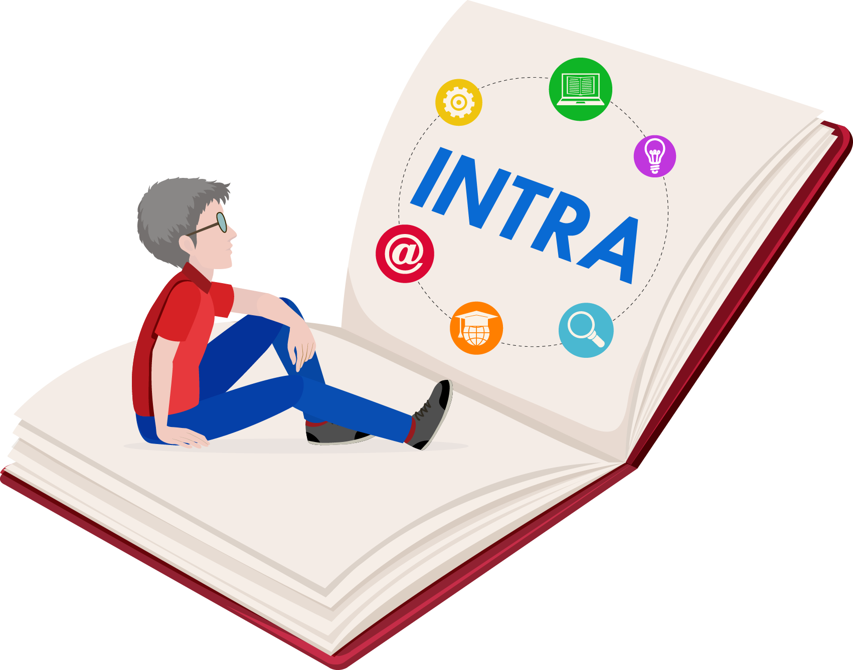

Quick Guide – Digital Counselor (Skillbot)
INTRA – 2022-1-IT02-KA220-ADU-000085744
Disclaimer: Funded by the European Union. Views and opinions expressed are however those of the author(s) only and do not necessarily reflect those of the European Union or the European Education and Culture Executive Agency (EACEA). Neither the European Union nor EACEA can be held responsible for them.

Slide 2
What is the Digital Counselor?
The Digital Counselor, also called 'Skillbot', is a virtual assistant designed to support adult learners during their educational journey on the INTRA e-learning platform.
It provides guidance, suggestions, and personalized learning support based on the user's needs and preferences.

Slide 3
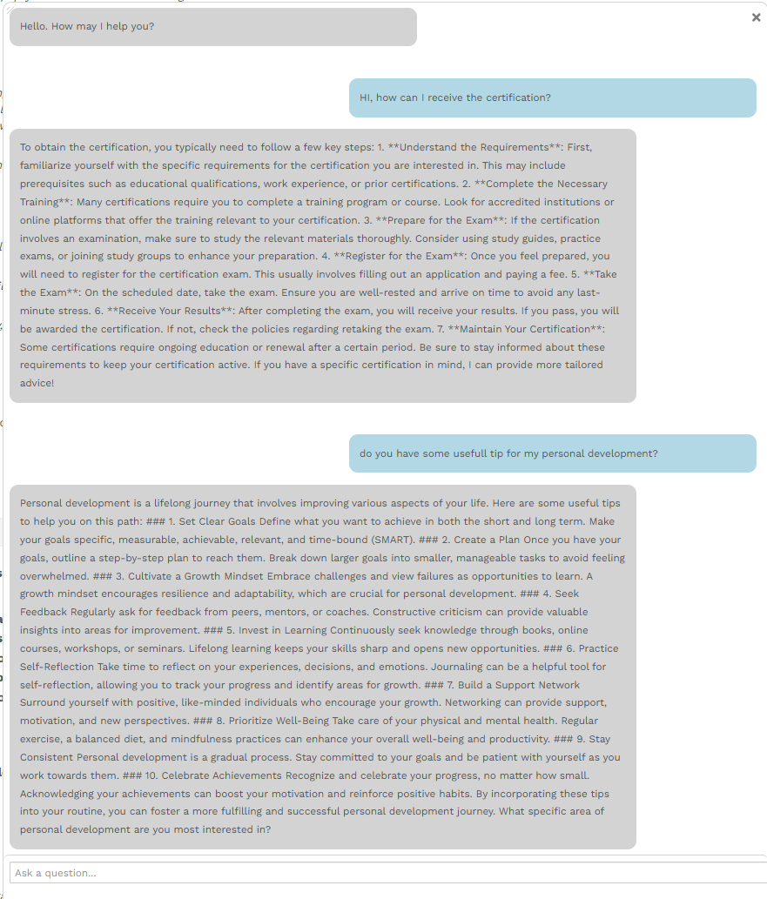
Example of a chat conversation within the INTRA platform

Slide 4
Key Features
Welcome guidance upon first login
Recommends modules based on user profile
Provides reminders, reflections, and motivational tips
Offers personalized suggestions and self-assessment prompts

Slide 5
How to Use the Digital Counselor
Log into the INTRA platform with your credentials.
Locate the chat window (bottom-right corner) to start Skillbot.
Answer initial questions to customize your learning experience.
Follow recommendations: course links, documents, reflective prompts.

Slide 6
Tips for Effective Use
Interact regularly to receive updated suggestions.
Be honest in your answers to get the best recommendations.
Use the counselor as guidance, not as a constraint.
Feel free to explore the platform beyond the suggested path.

Slide 7
Final Thoughts
Skillbot is a helpful and intelligent companion in your learning path.
Take advantage of its support to grow, reflect, and choose the most suitable learning resources for you.
Keep learning, keep growing!

